Slide 1
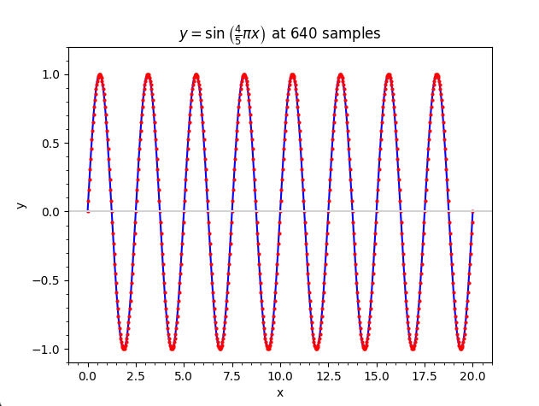
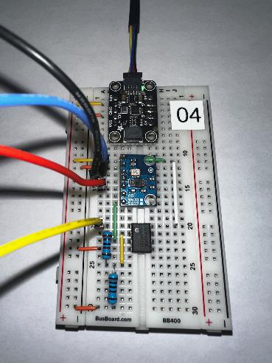
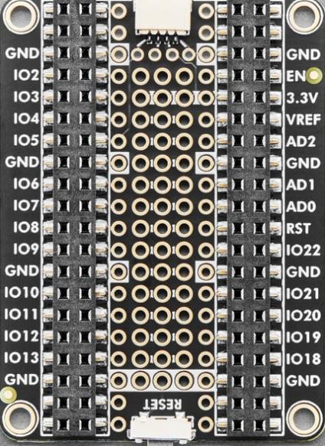
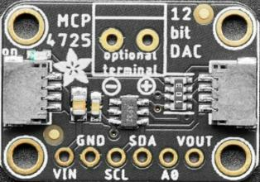
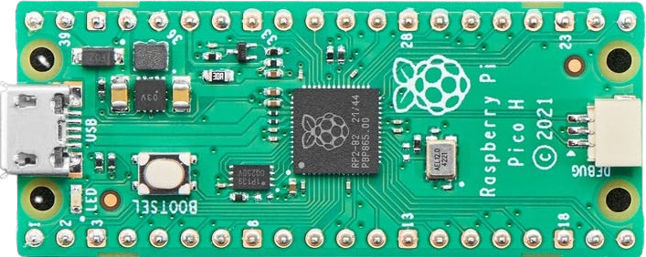
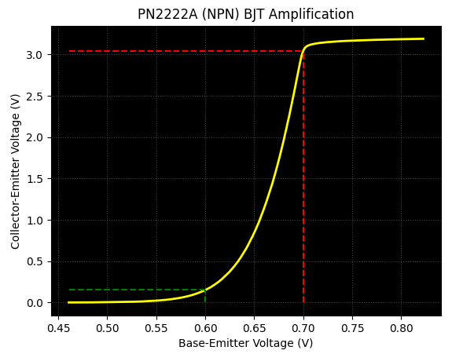

Control System Electronics 101
Using Python and Sensors to Measure Circuits
Board 04
Signal Generators,
Operational Amplifiers,
RLC Resonance
Dave Biersach
dbiersach@bnl.gov

Slide 2
Board 04 – Goals – Part 1 of 2
Understand how a signal generator can create sine waves of oscillating voltage at a requested frequency
Learn about the Serial Peripheral Interface (SPI) and its strengths/weaknesses compared to the I²C interface
Create an oscilloscope by sampling and plotting captured waveform data
Analyze the negative feedback loop of an operational amplifier to understand how it achieves controllable gain

Slide 3
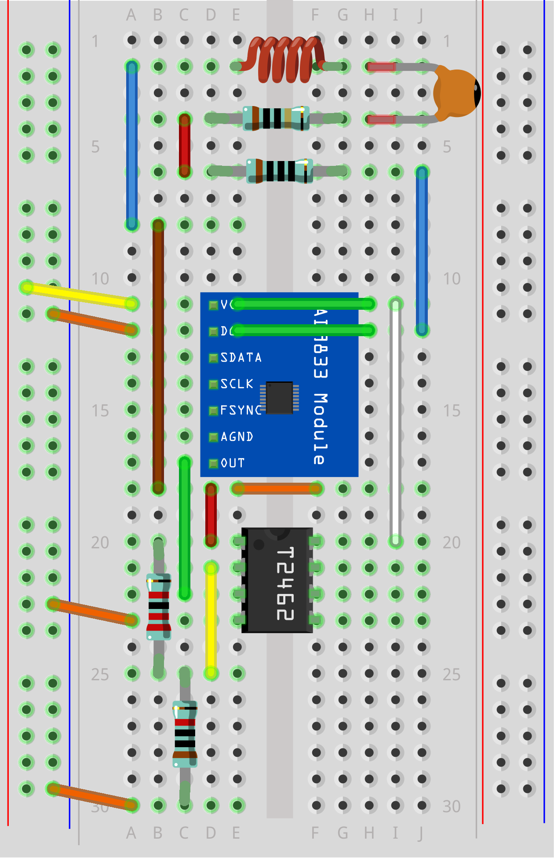
Review Board 04
Board 04 will introduce you to a signal generator, an operational amplifier (Op Amp), and a resistor-capacitor-inductor (RLC) series circuit
100 mH Inductor
10 Ω
Resistor
100 nF Capacitor
100 Ω
Resistor
Signal
Generator
22K Ω
Resistor
TLV2462
Op Amp
10K Ω
Resistor

Slide 4
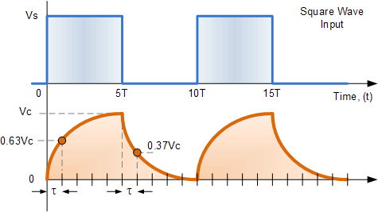
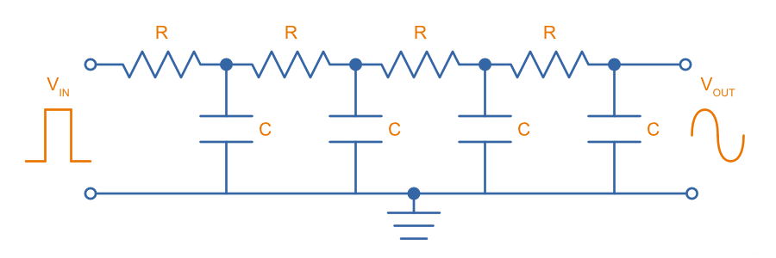
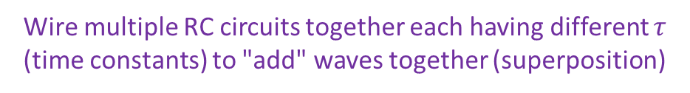
Generating Sinusoids (Waves)
We have this:
We want this:
Solution:
Wire multiple RC circuits together each having different $τ$ (time constants) to "add" waves together (superposition)

Slide 5
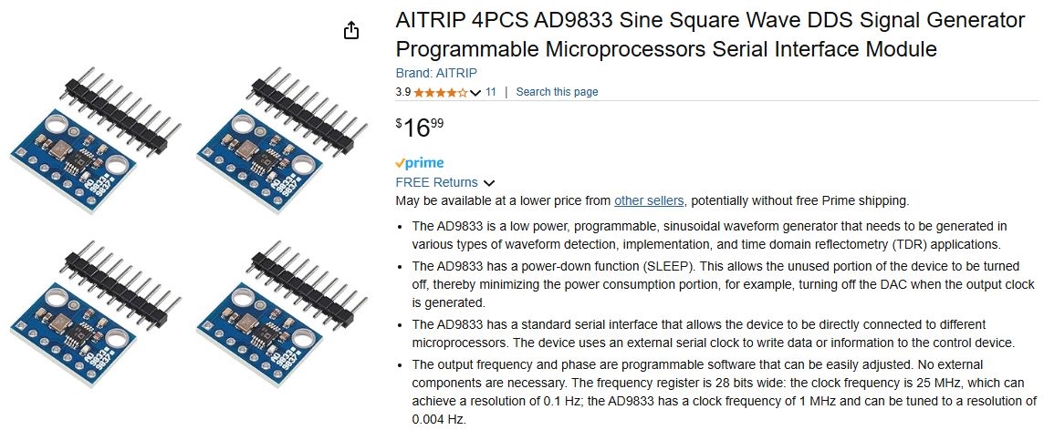
AITRIP AD9833 – Signal Generator with SPI
https://www.amazon.com/gp/product/B09154XMGS

Slide 6
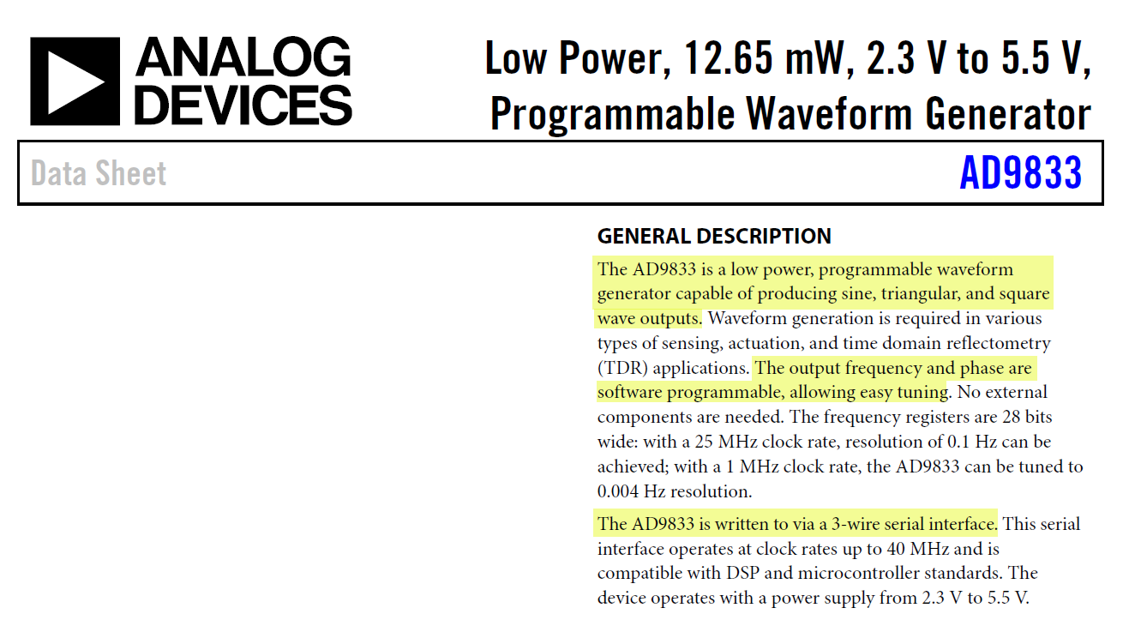
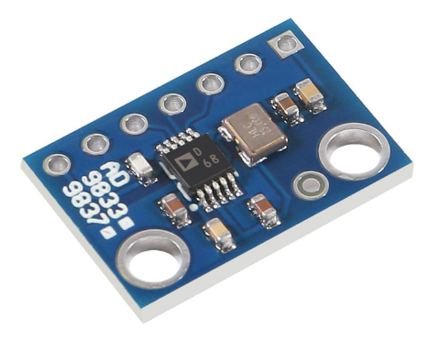
Always Consult the Product Datasheet
Trust nothing – measure everything ☺
https://www.analog.com/media/en/technical-documentation/data-sheets/ad9833.pdf
0 MHz to 12.5 MHz
Output Frequency Range

Slide 7
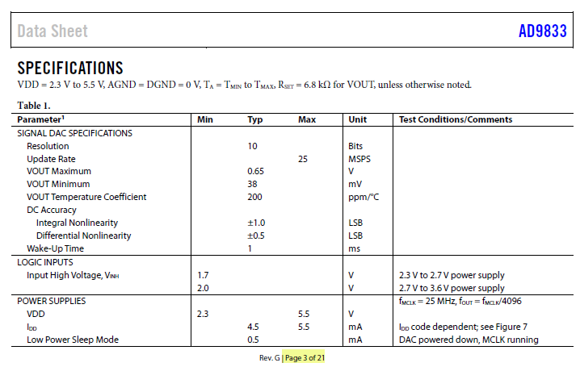
Analog Devices AD9833 Datasheet
Trust nothing – measure everything ☺
Will the sine wave reach +3.3V at its maximum value?
Even though the range of a sine wave swings below zero, will we get a negative voltage?

Slide 8
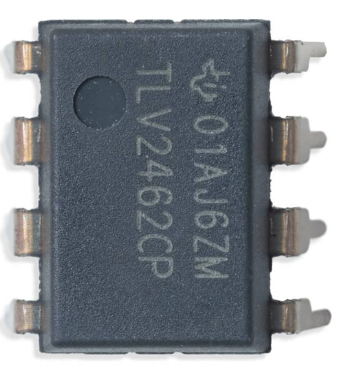
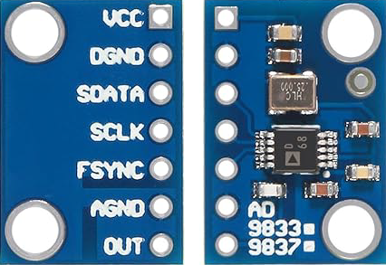
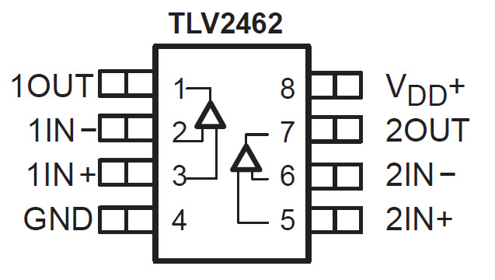
Power Flow (Vcc = +3.3V)
Analog Devices
AD988
Texas Instruments TLV2562
Bottom View
Top
View
V_{cc} = Positive Collector (BJT)
same as
V_{dd} = Positive Drain (MOSFET)

Slide 9
Power Flow (GND)
Analog Devices
AD988
Texas Instruments TLV2562
Bottom View
Top
View
SDATA
SCLK
FSYNC
= SPI Data
= SPI Clock
= SPI Chip Select

Slide 10
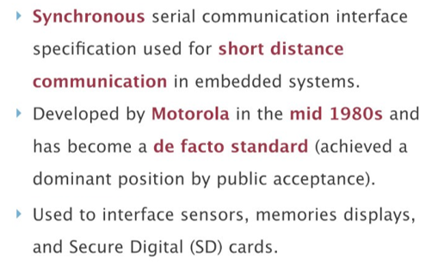
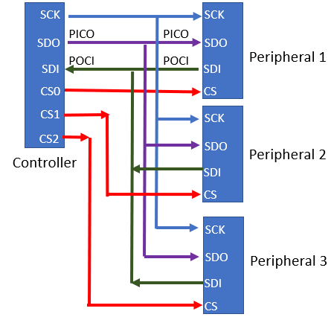
Serial Peripheral Interface (SPI)
SCK = Serial Clock (to synchronize chips)
SDI = PICO = Peripheral In / Controller Out
SDO = POCI = Peripheral Out / Controller In
CS# = Chip Select ↔ FSYNC = Frame Sync

Slide 11
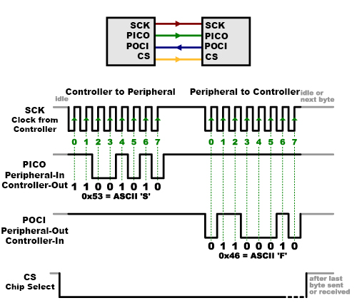
Serial Peripheral Interface (SPI)
Controller (RP2040)
Peripheral(AD8933)

Slide 12
SPI vs I²C
An SPI bus requires a dedicated (independent) Chip Select (CS) line per peripheral attached to the bus, which can quickly complicate wiring and increase manufacturing costs
But an I²C bus only needs two wires, which can be daisy-chained between components
Yes, the Adafruit Stemma-QT and SparkFun Qwiic cables add Vcc and GND wires to the standard I²C SDA and SCL wires, thus making four wires total - but this makes it easy to distribute power to all components with just one cable
However, at the signaling level, SPI is much faster than I²C. SPI is full-duplex at 50 MHz or higher, while I²C is message-based and has a typical bus speed of only 400 kHz

Slide 13
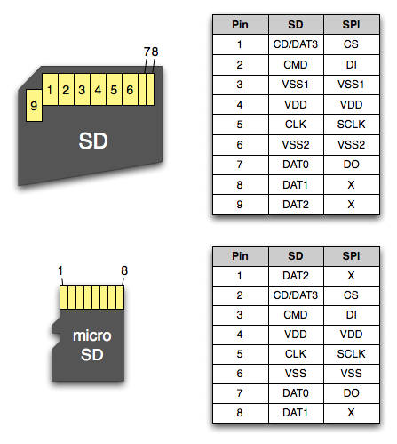

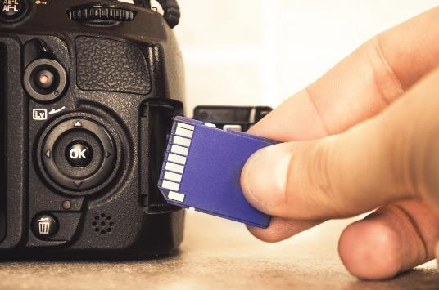
Serial Peripheral Interface (SPI)

Slide 14
Unplug the MCU before changing any wiring!
As we move between each “experiment” on a given breadboard or switch to an entirely new Board #, it is crucial that you FIRST UNPLUG the USB cord!
I recommend unplugging the cord at the PC end – leave the cord connected to the Micro USB port on the Pico
It is dangerous to change any wiring while the MCU is still drawing power from your laptop’s USB port. (NOTE: We will do this only during this Ohm’s Law lab on Board #3!)
If you incorrectly connect a jumper wire between the Pico and the breadboard while the Pico is drawing power from your PC, you can permanently damage your PC’s USB port
Have your partner double-check your wiring every step!

Slide 15
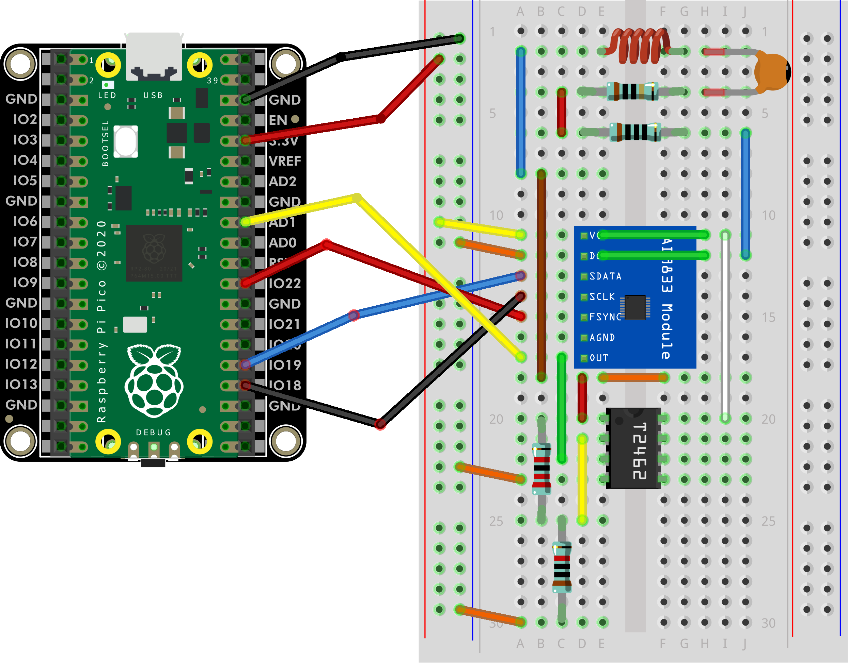
Wire Your Pico to Board 04
YELLOW
RED
BLUE
BLACK
→ AD1
→ IO22
→ IO19
→ IO18
→ OUT
→ FSYNC
→ SDATA
→ SCLK

Slide 16
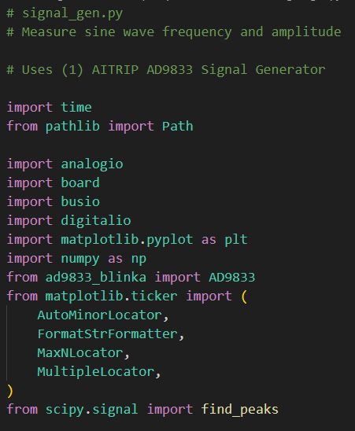
Open signal_gen.py
①
②

Slide 17
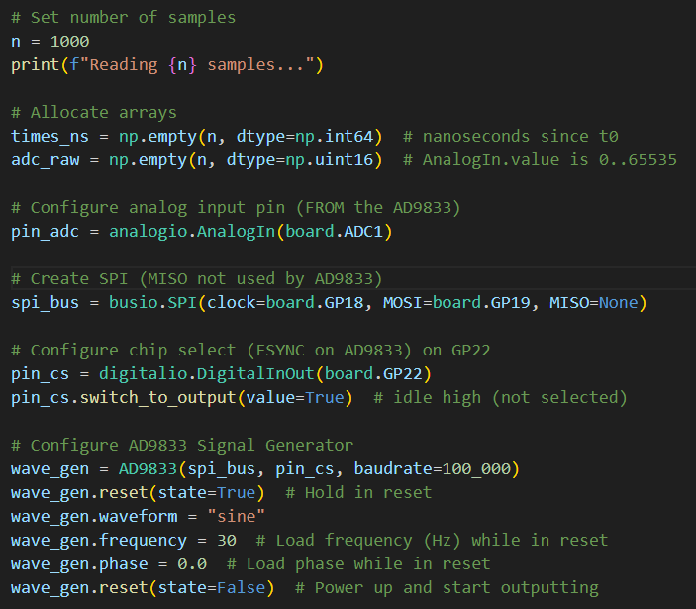
View signal_gen.py
①
②
③
④
⑤
⑥
⑦

Slide 18
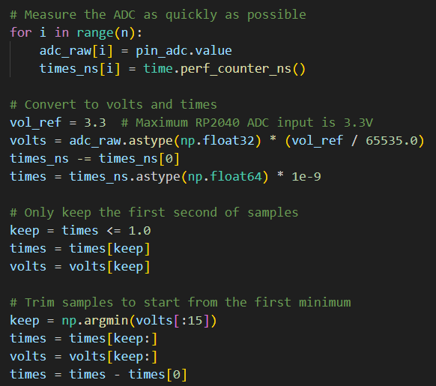
View signal_gen.py
①
②
③
④
⑤
⑥
⑦

Slide 19
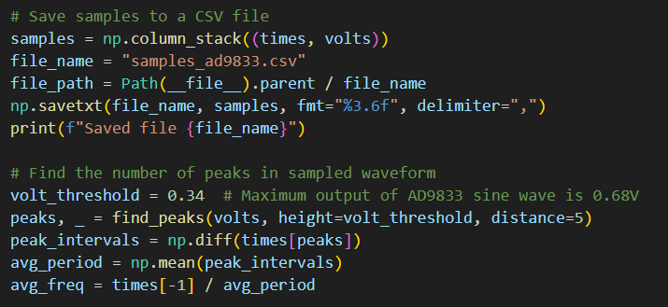
View signal_gen.py
①
③
②
④
⑤
⑥
⑦

Slide 20
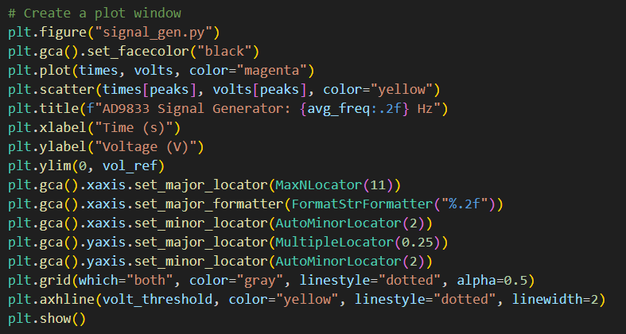
View signal_gen.py
①
②
③
④

Slide 21
Connect the Pico to Your PC
If you incorrectly connect a jumper wire between the Pico and the breadboard, you can permanently damage your PC’s USB port!
Have your partner double-check your wiring before you plug in the USB cable back into your PC

Slide 22
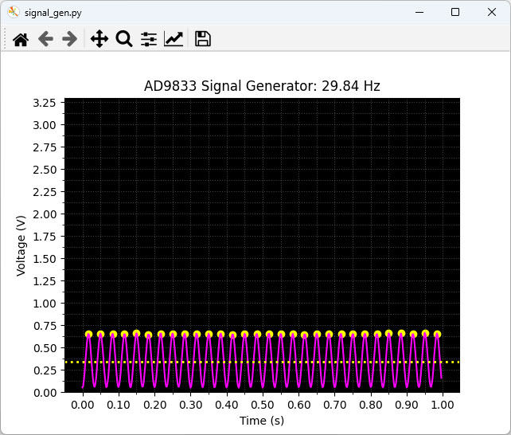
Run signal_gen.py
Recall our predictions for this experiment:
We should sample for 1 sec
We should see 30 peaks at 30 Hz
The max voltage should be ~0.68V
The voltage should not go below 0V

Slide 23
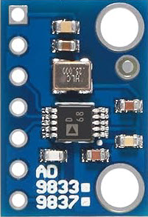
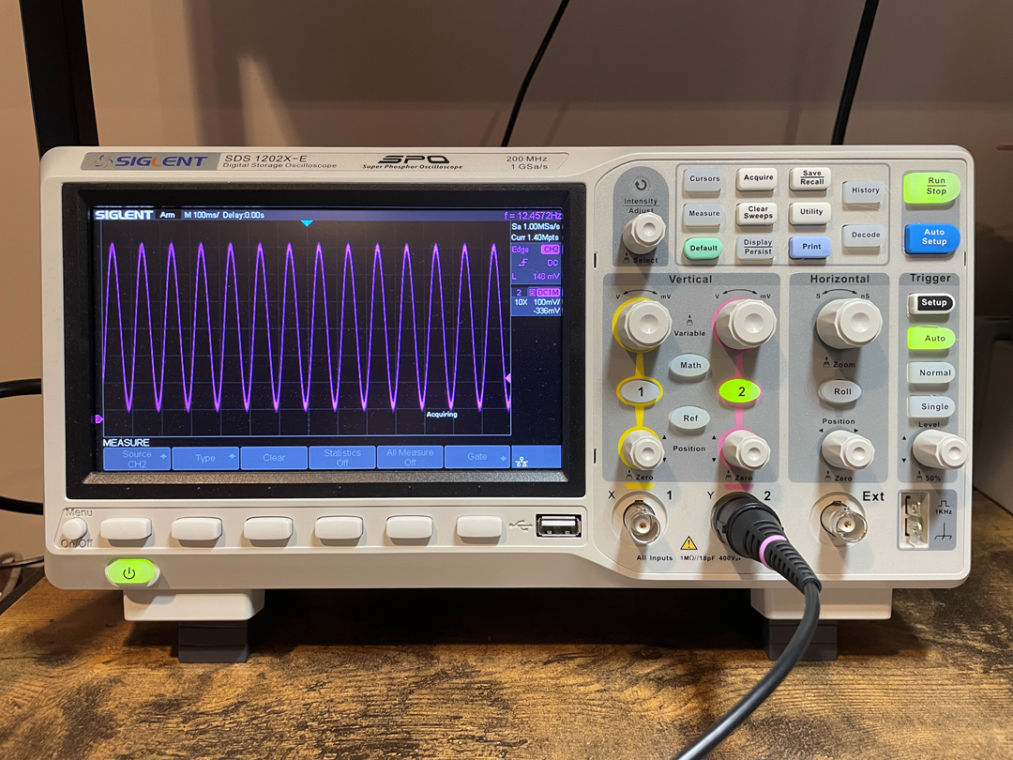

Slide 24
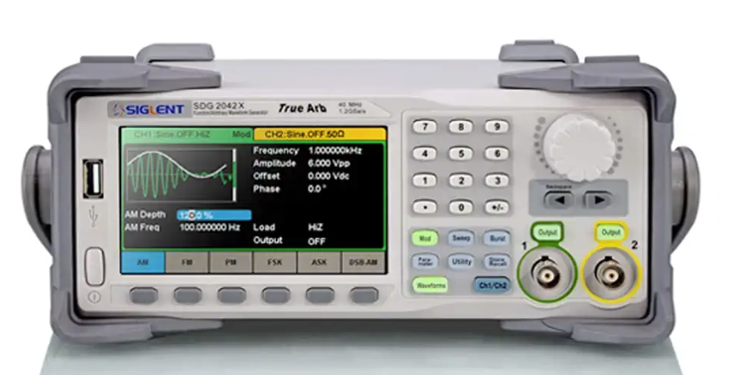
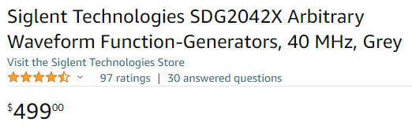
The Value of Knowing How to Code
$4.25

Slide 25
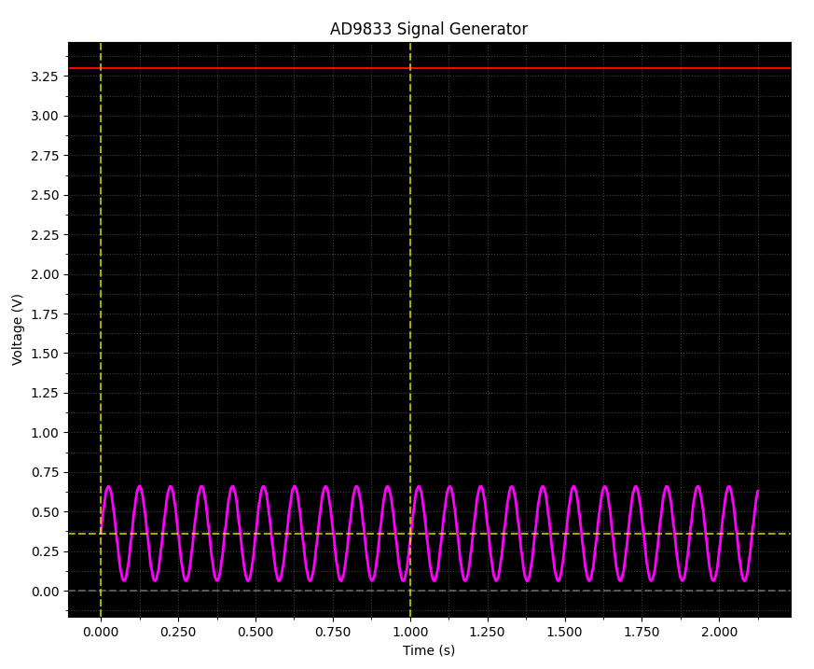
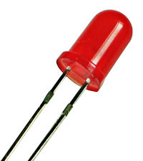
But what if we want to blink an LED?
A light emitting diode (LED) requires +2.0V to shine visible light, so we must figure a way to boost the output voltage of the AD9833 chip

Slide 26
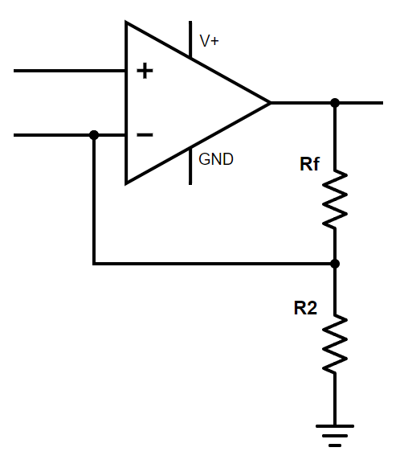

Operational Amplifiers
Output
Pin
Input Pins
$$=0 V$$
OP AMP
Rf = “Feedback” Resistor
An Op-Amp strives to keep a zero-voltage difference between the two input pins…
Here, we see a voltage divider placed on the Op-Amp output pin, with the middle tap routed back to the inverting input pin
Negative Feedback Loop
…when provided a negative feedback loop from the output
This Op Amp circuit is a non-inverting amplifier that does not affect the phase of the input signal

Slide 27
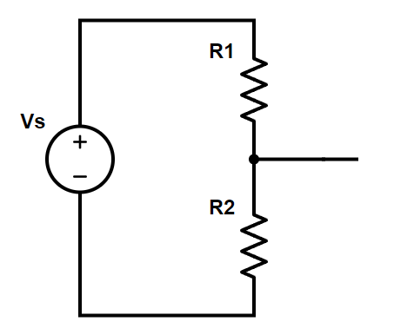
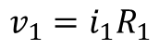
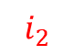
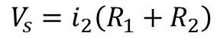
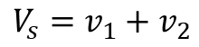
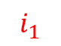
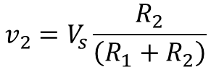
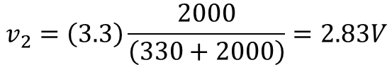
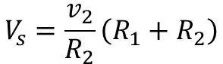
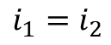
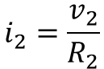
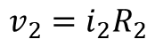
A Voltage Divider
KVL
$$V_{s}=v_{1}+v_{2}$$
Ohms
$$v_{1}=i_{1}R_{1}$$
330Ω
+3.3V
Ohms
$$v_{2}=i_{2}R_{2}$$
$$i_{1}$$
+ ?? V
KCL
$$i_{1}=i_{2}$$
+ 2.83V
$$i_{2}$$
$$V_{s}=i_{2}\left(R_{1}+R_{2}\right)$$
$$i_{2}=\frac{v_{2}}{R_{2}}$$
2KΩ
$$V_{s}=\frac{v_{2}}{R_{2}}\left(R_{1}+R_{2}\right)$$
$$v_{2}=V_{s}\frac{R_{2}}{\left(R_{1}+R_{2}\right)}$$
$$v_{2}=\left(3.3\right)\frac{2000}{\left(330+2000\right)}=2.83V$$

Slide 28
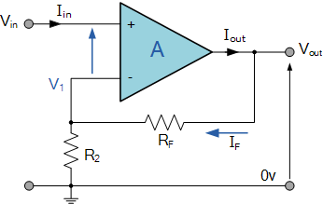
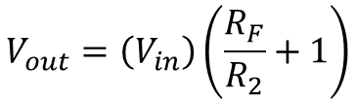




Operational Amplifiers
$$V_{1}=V_{in}$$
$$V_{1}=\left(V_{out}\right)\frac{R_{2}}{R_{F}+R_{2}}$$
R_{F} and R₂ form a voltage divider
R_{F} is the "feedback" resistor
$$V_{in}=\left(V_{out}\right)\frac{R_{2}}{R_{F}+R_{2}}$$
Gain Formula for Op-Amp
$$V_{out}=\left(V_{in}\right)\frac{R_{F}+R_{2}}{R_{2}}$$
$$V_{out}=\left(V_{in}\right)\left(\frac{R_{F}}{R_{2}}+1\right)$$

Slide 29




Operational Amplifiers
+3.3V
This circuit generates a 3.2x gain
Max +0.68V
from the
AD9833
$$V_{in}$$
+2.18V ✓
22K Ω
Non-Inverting Op-Amp Gain Formula
$$V_{out}=\left(V_{in}\right)\left(\frac{R_{F}}{R_{2}}+1\right)$$
10K Ω
TLV2462 Op Amp
$$V_{out}=\left(0.68\right)\left(\frac{22}{10}+1\right)=\left(0.68\right)\left(3.2\right)=2.18V$$

Slide 30



Always Consult the Product Datasheet
Trust nothing – measure everything ☺
https://www.ti.com/lit/gpn/tlv2462
✓
Pin Out
✓
rail
✓
rail
+2.0V
20mA
✓

Slide 31
Unplug the MCU before changing any wiring!
As we move between each “experiment” on a given breadboard or switch to an entirely new Board #, it is crucial that you FIRST UNPLUG the USB cord!
I recommend unplugging the cord at the PC end – leave the cord connected to the Micro USB port on the Pico
It is dangerous to change any wiring while the MCU is still drawing power from your laptop’s USB port. (NOTE: We will do this only during this Ohm’s Law lab on Board #3!)
If you incorrectly connect a jumper wire between the Pico and the breadboard while the Pico is drawing power from your PC, you can permanently damage your PC’s USB port
Have your partner double-check your wiring every step!

Slide 32

Wire Your Pico to Board 04
TLV2462
Op Amp
Just move the yellow jumper down to the first tie point in Row 20

Slide 33

Open op_amp.py
①
②

Slide 34

View op_amp.py
①
②
③
④

Slide 35
Connect the Pico to Your PC
If you incorrectly connect a jumper wire between the Pico and the breadboard, you can permanently damage your PC’s USB port!
Have your partner double-check your wiring before you plug in the USB cable back into your PC

Slide 36

Run op_amp.py
Recall our predictions for this experiment:
The Op Amp provides a 3.2 gain
The max voltage is now ~2.18V
The Op Amp doesn’t affect phase

Slide 37

This can blink a Red LED!

Slide 38




Operational Amplifiers
Wien Bridge Oscillator (1939)
Bill Hewlett was 25 years old at the time
Bill Hewlett
1913-2001
Bill Hewlett & David Packard
HP 200A
https://en.wikipedia.org/wiki/Fantasound
(1940)

Slide 39




The Mathematical Operations of an Op-Amp
"Adder"
"Subtractor"
"Differentiator"
"Integrator"

Slide 40







An Operational Amplifier From Transistors
An Op Amp Implemented Using NPN BJTs
$$V_{out}=\left(V_{in}\right)\left(1+\frac{200}{100}\right)$$
200k$Ω$ (R_{F})
100k$Ω$ (R₂)
$$V_{out}=V_{in}×3$$
The Gain would be 3x

Slide 41
Board 04 – Goals – Part 2 of 2
Understand how inductors store energy in a magnetic field
Differentiate impedance, resistance, and reactance
Appreciate that RLC circuits have a natural resonant frequency at which they oscillate
Simulate an RLC circuit using Euler's Method to numerically estimate its frequency response
Learn about how spectrum analyzers work and the value they provide engineers and technicians
Contrast the root mean squared (RMS) of a sinusoidal (alternating) signal versus using the simpler arithmetic mean to calculate the average value of the signal

Slide 42



Inductors and Impedance
An inductor is a passive two-terminal electrical component that stores energy in a magnetic field when electric current flows through it. An inductor typically consists of an insulated wire wound into a coil
When the current flowing through the coil changes, the time-varying magnetic field induces a voltage which opposes the change in current that created it. As a result, inductors oppose any changes in current passing through them

Slide 43
Inductors and Impedance
Inductors slow down current surges or spikes by temporarily storing energy in an electromagnetic field and then releasing it back into the circuit
Inductors are very common in power supplies, such as to create a buck or boost converter and they are common in radio circuits to create oscillators and filters
Electromagnets are the most often used inductors. Everything that moves due to electricity, such as relays, motors, solenoids, speakers, etc. uses inductors
Transformers are basically two inductors wound around the same core

Slide 44


Inductors and Impedance

Slide 45

Inductors and Impedance

Slide 46

RLC Circuit – Total Impedance

Slide 47



Inductors and Impedance

Slide 48


An Undriven RLC Circuit
Lacking additional energy, the circuit's power drains away as it transforms into heat within the resistor.

Slide 49
An Undriven RLC Circuit
Every RLC circuit has a specific fixed fundamental frequency in which it oscillates based on its
L and C values

Slide 50

Driven Oscillators - Resonance
A system driven at its resonant frequency will experience maximum amplitude

Slide 51

Driven Oscillators - Resonance
As the driving frequency pushes the circuit's oscillations closer to its resonant frequency, the circuit power will increase

Slide 52




Driven Oscillators - Resonance
At the resonant frequency, the capacitive reactance in the LC components equals the inductive reactance, and therefore their impedance drops to zero – all that remains is the resistance of the R, L, C components
0
$$Z=\sqrt{R^{2}+{\left(X_{L}−X_{C}\right)}^{2}}$$
$$Z=R$$
$$X_{c}=X_{L}$$

Slide 53

Finding a Circuit’s Resonant Frequency
For simple circuits, like our RLC lab, we can directly compute the theoretical resonant frequency:
$$ω_{0}=\frac{1}{2π\sqrt{LC}} (in Hz)$$
However, due to tolerance variations in the components, the actual resonant frequency might be reasonably away from its theoretical value
Circuits more complicated than a simple series RLC network might not even have a closed-form (analytic) formula expressing its resonant frequency, or the circuit might have multiple different regions of resonance

Slide 54




A Driven RLC Circuit
The RLC Circuit is "powered" (driven) by the AD9833+TLV2462
100mH
100nF
V_{OUT}
SPI Bus
10Ω
TLV2462
Op Amp
We will measure the voltage at the 10Ω resistor
100Ω

Slide 55






Finding a Circuit’s Resonant Frequency
$$ω=\frac{1}{\sqrt{LC}}$$
$$f=\frac{1}{2π\sqrt{\left(100.8×{10}^{−3}\right)\left(91.2×{10}^{−9}\right)}}$$
$$f=\frac{ω}{2π}$$
$$f=\frac{16599 Hz}{1}×\frac{1 kHz}{1000 Hz}=1.6599 kHz$$
$$f=\frac{1}{2π\sqrt{LC}}$$

Slide 56




Root Mean Squared (RMS) vs. Mean
$$\sin{x}$$
$$μ=\frac{1}{2π}\int_{0}^{2π}{\sin{xⅆx}}=0$$
☹
What is the average power of this signal?
$$2π$$

Slide 57

Root Mean Squared (RMS) vs. Mean
$$\sin{x}$$
$$μ=\frac{1}{2π}\int_{0}^{2π}{\sin{xⅆx}}=0$$
☹
But we are now only considering half of the full cycle!
$$2π$$
$$μ_{+}=\frac{1}{π}\int_{0}^{π}{\sin{xⅆx}}=\frac{2}{π}$$
$$≅0.6366$$
😐

Slide 58







Root Mean Squared (RMS) vs. Mean
$$\sin^{2}{x}$$
$$μ=\frac{1}{2π}\int_{0}^{2π}{\sin{xⅆx}}=0$$
☹
$$u_{RMS}$$
$$u_{+}$$
$$μ_{+}=\frac{1}{π}\int_{0}^{π}{\sin{xⅆx}}=\frac{2}{π}$$
$$≅0.6366$$
😐
$$2π$$
$$μ_{RMS}=\sqrt{\frac{1}{2π}\int_{0}^{2π}{\sin^{2}{xⅆx}}}=\frac{1}{\sqrt{2}}=\frac{\sqrt{2}}{2}$$
$$≅0.7071$$
Mean is used to get the central tendency of a given data set while RMS is used when random variables given in the data are both negative and positive, such as in sinusoids
☺

Slide 59
Unplug the MCU before changing any wiring!
As we move between each “experiment” on a given breadboard or switch to an entirely new Board #, it is crucial that you FIRST UNPLUG the USB cord!
I recommend unplugging the cord at the PC end – leave the cord connected to the Micro USB port on the Pico
It is dangerous to change any wiring while the MCU is still drawing power from your laptop’s USB port. (NOTE: We will do this only during this Ohm’s Law lab on Board #3!)
If you incorrectly connect a jumper wire between the Pico and the breadboard while the Pico is drawing power from your PC, you can permanently damage your PC’s USB port
Have your partner double-check your wiring every step!

Slide 60

Wire Your Pico to Board 04
Just move the yellow jumper up to Row 7

Slide 61

Open rlc_measure.py

Slide 62

View rlc_measure.py
①

Slide 63

View rlc_measure.py
①
②
③
④
⑤
⑥
⑦
⑧

Slide 64

View rlc_measure.py
①
②
③
④

Slide 65
Connect the Pico to Your PC
If you incorrectly connect a jumper wire between the Pico and the breadboard, you can permanently damage your PC’s USB port!
Have your partner double-check your wiring before you plug in the USB cable back into your PC

Slide 66

Run rlc_measure.py

Slide 67

Open rlc_plot_actual.py
①
②

Slide 68

View rlc_plot_actual.py
①
②
③
⑤
④
⑥

Slide 69

Run rlc_plot_actual.py

Slide 70


















Simulating a Driven RLC Circuit
$$ε=EMF=+1.1V$$
$$V_{s}=ε\sin\left(ωt\right)$$
AC Voltage Source
$$V_{R}=IR$$
Ohm's Law
Voltage across the resistor
10.20Ω 99.50Ω
R
$$V_{L}=L\frac{ⅆI}{ⅆt}$$
Faraday's Law
S
$$V_{C}=\frac{Q}{C}$$
Gauss's Law
101.6mH
L
$$V_{s}=V_{R}+V_{L}+V_{C}$$
Kirchhoff's Voltage Law
93.7
uF
C
Euler's Method
$$V_{s}=IR+L\frac{ⅆI}{ⅆt}+\frac{Q}{C}$$
$$Q_{n+1}=Q_{n}+I_{n}ⅆt$$
$Q=$ Charge (in Coulombs)
$$V_{s}=IR+Lα+\frac{Q}{C}$$
$$I_{n+1}=I_{n}+αⅆt$$
$I=$ Current (in Amps)
$$V_{n+1}=V_{n}+IR$$
$$\frac{ⅆQ}{ⅆt}=I$$
$$\frac{ⅆI}{ⅆt}=α$$
$$α=\frac{\left(V_{s}−IR−Q/C\right)}{L}$$
$$t_{n+1}=t_{n}+ⅆt$$

Slide 71

Open rlc_plot_theory.py
①
②
③
④
⑤
⑥

Slide 72

View rlc_plot_theory.py
①
②
③

Slide 73



View rlc_plot_theory.py

Slide 74

Run rlc_plot_theory.py

Slide 75
Check rlc_plot_theory.py
At resonance, the LC elements have nearly zero resistance, so the current (and hence voltage) flowing through R1 (and R2) would be at the maximum

Slide 76

Check rlc_plot_theory.py
Engineers must contend with the real world where nothing is exact or consistent

Slide 77
Finding a Circuit’s Resonant Frequency
A spectrum analyzer (SA) is an advanced benchtop instrument used to measure a circuit's response as the circuit's inputs are systematically swept across a wide range of frequencies
By plotting circuit measurements like output voltage, the SA can help identify the frequencies that induce resonance
This analysis is crucial when designing radios and antennas that can transmit and receive signals at specific frequencies
We need a SA to design and test cell towers, Wi-Fi stations, GPS satellites, radar detectors, laser ranging devices, and even acoustical instruments

Slide 78

The Value of Knowing How to Code
☹

